Slide 1
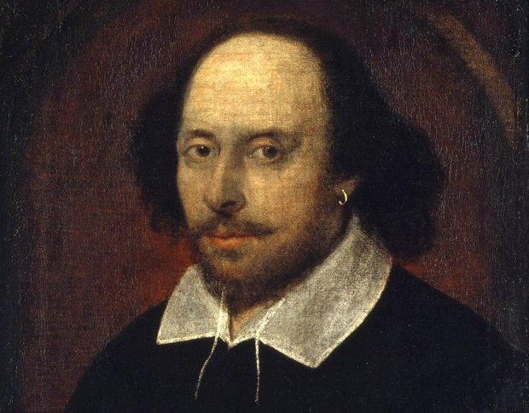
Topic
Is any merit to conspiracy theory that Shakespeare was
multiple authors
Rebecca Karunakaran Warren Brewster Louis Haskins

Slide 2
Project Goals
● Is any merit to conspiracy theory that Shakespeare
was multiple authors
Potential authors include Francis Bacon, the Earl of Oxford, Christopher
Marlowe,and the Earl of Derby
● Who wrote Hamlet (or at least, who didn’t)
Is Hamlet’s hesitation due to an intentional character flaw or poor writing craft
Can text mining differentiate different characteristics between Male and Female actors in Shakespeare's play?

Slide 3
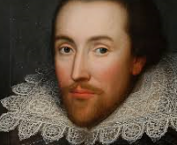
About Shakespeare
William Shakespeare was an English poet and playwright who is considered one of the greatest writers to ever use the English language. He is also the most famous playwright in the world, with his plays being translated in over 50 languages and performed across the globe for audiences of all ages.
His works span tragedy, comedy, and historical works, both in poetry and prose.
Between about 1590 and 1613, Shakespeare wrote at least 37 plays and collaborated on several more. His 17 comedies include The Merchant of Venice and Much Ado About Nothing. Among his 10 history plays are Henry V and Richard III. The most famous among his tragedies are Hamlet, Othello, King Lear and Macbeth.

Slide 4

About the Dataset
Dataset consists of 15 plays and 4 Poems
Comedy History Tragedy
All’s Well That Ends Well As You Like It A Midsummer Night’s Dream Much Ado about Nothing The Tempest The Winter’s Tale | King Henry IV First King John | Antony and Cleopatra Cymbeline Hamlet Julius Caesar King Lear Macbeth Romeo and Juliet

Slide 5
About the Dataset Continued
For author comparisons, a set of each author’s poems would be compared
Authors compared: Christopher Marlowe, Edward de Vere, William Shakespeare
Other authors researched either had little or no attributed poetry
13 poems attributed to Christopher Marlowe
20 poems attributed to Edward de Vere
19 poems attributed to William Shakespeare

Slide 6
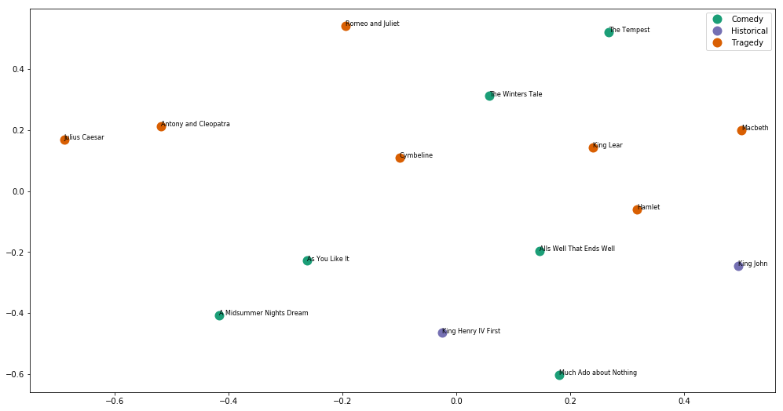
Did one person write all the play ?
Using euclidean distance
Play seem to be greatly distributed

Slide 7
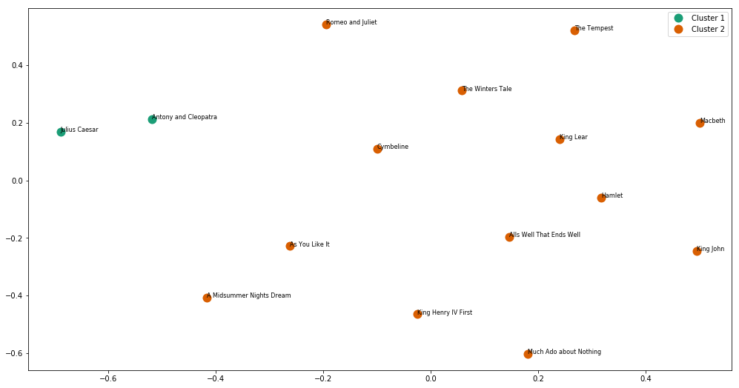
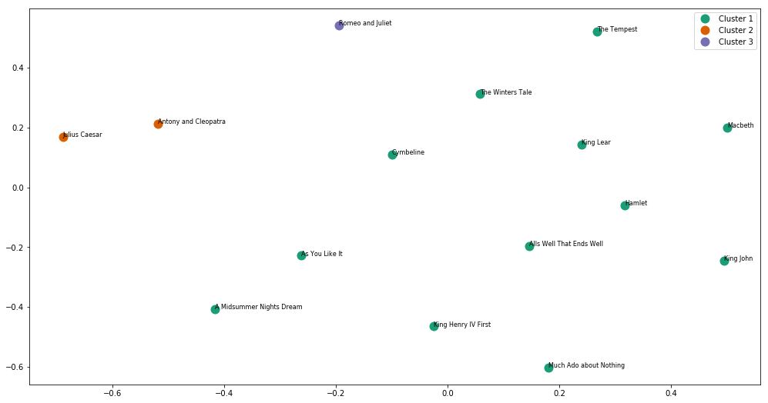
Making sense of play spread with K-means clustering
2 Clusters and 3 Clusters

Slide 8
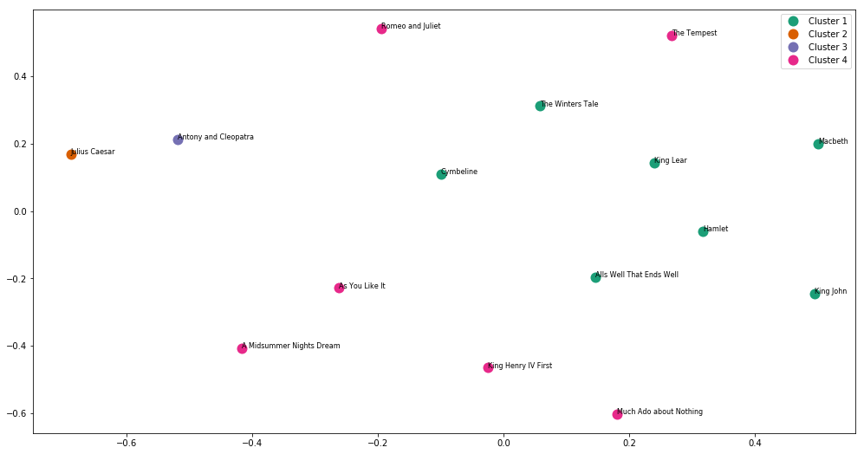
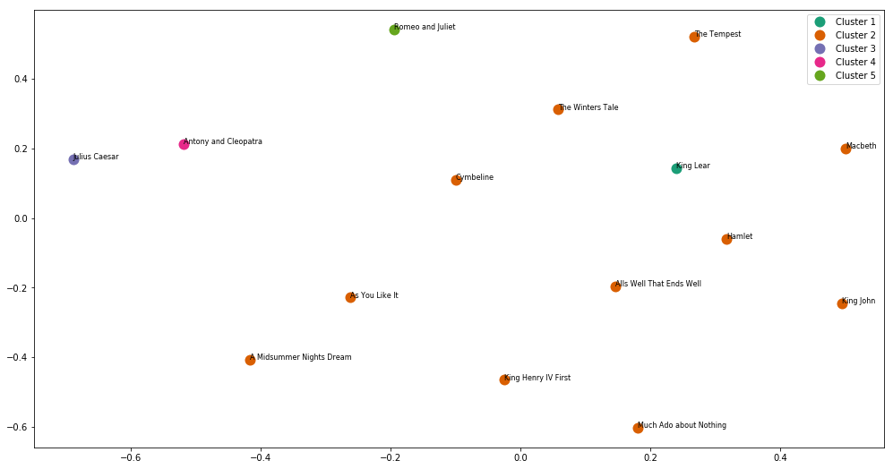
Making sense of play spread with K-means clustering
4 Clusters and 5 Clusters

Slide 9
Potential Authors
1 = Christopher Marlowe
2 = Edward de Vere
3 = William Shakespeare
Histogram of MNB posterior probabilities when author probability greater than 10%
Bin | Frequency
1 | 32
2 | 72
3 | 56
12 | 30
13 | 60
23 | 36
123 | 50
Confusion Matrix Average for 16 poems across all models | 1 | 2 | 3
1 | 1.190476 | 0.380952 | 2.142857
2 | 0.785714 | 4.071429 | 1.571429
3 | 2.547619 | 0.642857 | 2.642857

Slide 10
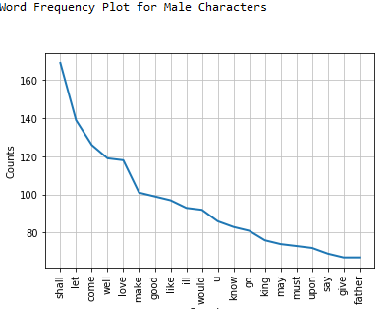
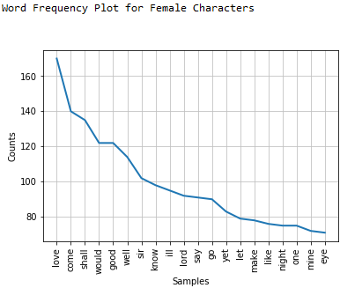
Gender Analysis
Corpus with 9000 speaking line was created and the Actor and Gender were identified
Corpus was evenly split into about 4500 Male and 4500 Female speaking line
Word Frequency Analysis to determine feasibility of differentiating male characters from female ones

Slide 11
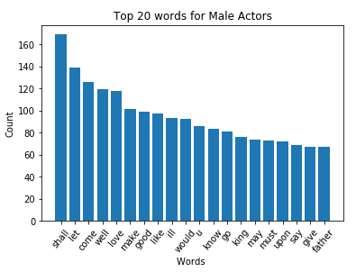
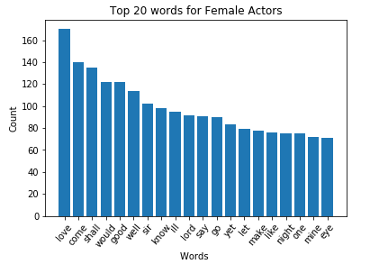
Gender Analysis - Top 20 words based on Gender

Slide 12
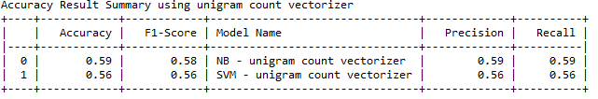
Gender Analysis - SVM and MNB classifiers
Using hold-out method using 70% of data from Training and 30% for Testing, MNB scored higher with 59% accuracy for Gender Classification

Slide 13
Results
This project has shown that MNB and SVM classifiers can be effective for differentiating between literary characters of different genders. Shakespeare did indeed write his male
and female characters to be both distinct from the opposite gender. Additionally, there is some evidence to suggest all of the works attributed to William Shakespeare could be by someone else, in particular Christopher Marlowe.

Slide 14

Challenges
Shakespeare's Plays had a lot more Male Actors compared to Female Actors - getting a balance dataset for Gender Analysis was quite a challenge
Stop Word List for Old English was another challenge (CLTK could not be installed for Anaconda). Solution was to create a custom list that was appended to NLTK stop word list.
Finding works attributed to authors was difficult. Some authors had to be dropped due to low number of poems to build models off of.

Slide 15
References
https://en.wikipedia.org/wiki/List_of_Shakespeare_authorship_candidates
https://en.wikipedia.org/wiki/History_of_the_Shakespeare_authorship_question

